Slide 1
CS4031 Compiler Construction Chapter 4 cont.
Faryal Saud
Lecturer, Department of Computer Science
FAST NUCES CFD

Slide 2
Problems in Grammars
Left Factoring
Left Recursion
Right Recursion
Left Most Derivation
Right Most Derivation

Slide 3
Left Factoring
Left factoring is a process by which the grammar with common prefixes is transformed to make it useful for Top down parsers.
Example:
A → αβ1 / αβ2 / αβ3
This kind of grammar creates a problematic situation for Top down parsers.
Top down parsers can not decide which production must be chosen to parse the string in hand.
To remove this confusion, we use left factoring.

Slide 4
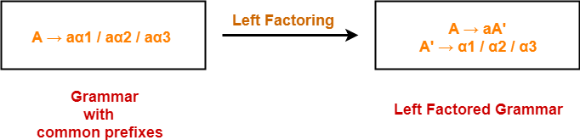
Example:

Slide 5
Left Recursion
A → Aα / β
Left recursion is considered to be a problematic situation for Top down parsers.
Therefore, left recursion has to be eliminated from the grammar.
Left-Recursion Elimination
we can eliminate left recursion by replacing the pair of productions with-
A → βA’
A’ → αA’ / ∈

Slide 6
Ambiguous to Unambiguous Grammar
Any grammar which consist of more than one derivation tree is called ambiguous grammar.
Removal Ambiguity
Two approaches are used to remove the ambiguity
Associativity Constraint
Precedence Constraint

Slide 7
Removal Ambiguity
Precedence Constraint
The precedence constraint is implemented using the following rules-
The level at which the production is present defines the priority of the operator contained in it.
The higher the level of the production, the lower the priority of operator.
The lower the level of the production, the higher the priority of operator.

Slide 8
Associativity Constraint Examples:
Consider the following Grammar
E → E + T | T
T → T * F | F
F → G ^ F | G
G → id
Operator in Grammar | Precedence
+ | 3
* | 2
^ | 1

Slide 9
Removal Ambiguity
Associativity Constraint
If the operator is left associative, induce left recursion in its production.
If the operator is right associative, induce right recursion in its production.
Associativity of operators
+, - left to right
*, / left to right
^ right to left

Slide 10
Associativity Constraint Examples:
Consider the following Grammar
E → E + T | T
T → T * F | F
F → G ^ F | G
G → id
Operator in Grammar | Associativity either left or right
+ | Left Associativity
* | Left Associativity
^ | Right Associativity

Slide 11
Example
E → E + E | E * E | id

Slide 12
First and Follow
First and follow sets are needed so that the parser can properly apply the needed production rule at the correct position.

Slide 13
First
First(α) is a set of terminal symbols that begin in strings derived from α.
Consider the production rule-
A → abc / def / ghi
Then, we have- First(A) = { a , d , g }

Slide 14
Follow
Follow(α) is a set of terminal symbols that appear immediately to the right of α.
For the start symbol S, place $ in Follow(S).
For any production rule A → αB,
Follow(B) = Follow(A)
For any production rule A → αBβ,
If ∈ ∉ First(β), then Follow(B) = First(β)
If ∈ ∈ First(β), then Follow(B) = { First(β) – ∈ } ∪ Follow(A)

Slide 15
Example:
Consider the following Grammar
E → E+T | T
T → T*F | F
F → id | (E)

Slide 16
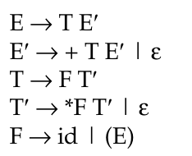
Example:
Consider the following Grammar
E → E+T | T
T → T*F | F
F → id | (E)
Remove the left recursion

Slide 17
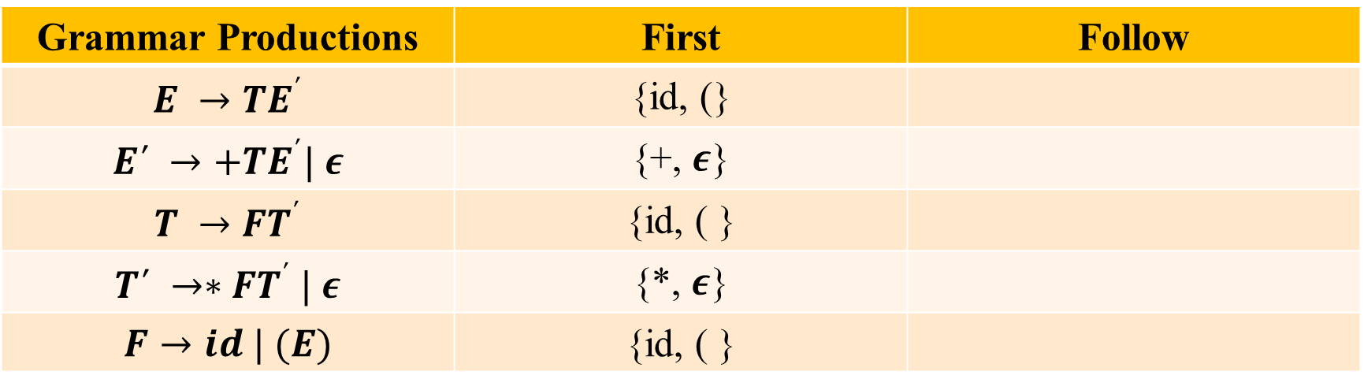
Now find the first and follow
Grammar Productions | First | Follow
$$E →TE^{΄}$$ | {id, (}
$$E΄ →+TE^{΄}| ε$$ | {+, $ε$}
$$T →FT^{΄}$$ | {id, ( }
$$T΄ →∗FT^{΄} | ε$$ | {*, $ε$}
$$F→id | (E)$$ | {id, ( }

Slide 18
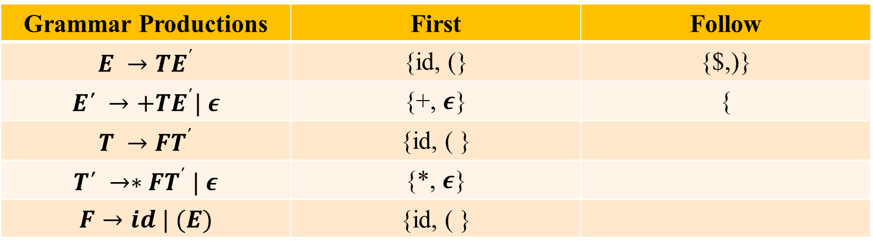
Now find the first and follow
Grammar Productions | First | Follow
$$E →TE^{΄}$$ | {id, (} | {$,)}
$$E΄ →+TE^{΄}| ε$$ | {+, $ε$} | {
$$T →FT^{΄}$$ | {id, ( }
$$T΄ →∗FT^{΄} | ε$$ | {*, $ε$}
$$F→id | (E)$$ | {id, ( }

Slide 19
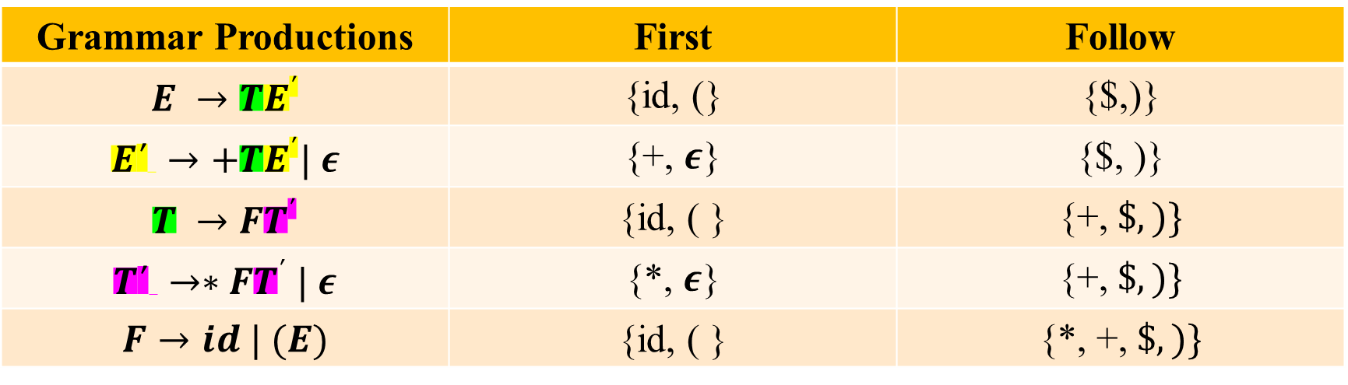
Now find the first and follow
Grammar Productions | First | Follow
$$E →TE^{΄}$$ | {id, (} | {$,)}
$$E΄ →+TE^{΄}| ε$$ | {+, $ε$} | {$, )}
$$T →FT^{΄}$$ | {id, ( } | {+, $\$, )\}$
$$T΄ →∗FT^{΄} | ε$$ | {*, $ε$} | {+, $\$, )\}$
$$F→id | (E)$$ | {id, ( } | {*, +, $\$, )\}$

Slide 20
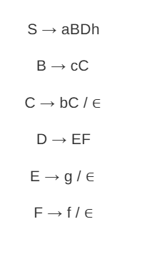
Calculate the first and follow of the following Grammar

Slide 21
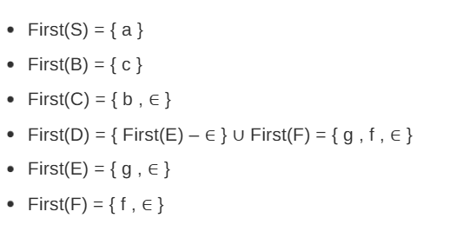
Solution: First

Slide 22
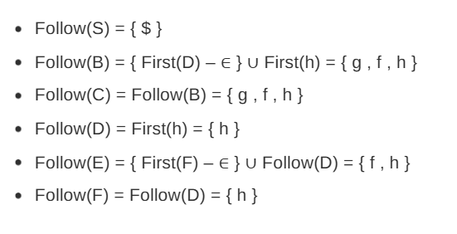
Follow

Slide 23
Example 2:
S -> ACB|Cbb|Ba
A -> da|BC
B-> g|Є
C-> h| Є

Slide 24
Example 2: First Solution
FIRST(S) = { d, g, h, Є, b, a}
FIRST(A) = { d, g, h, Є }
FIRST(B) = { g, Є }
FIRST(C) = { h, Є }

Slide 25
Follow
FOLLOW(S) = { $ }
FOLLOW(A) = { h, g, $ }
FOLLOW(B) = { a, $, h, g }
FOLLOW(C) = { b, g, $, h }

Slide 26
Parsing Technique
Parser
Top-Down Parser
Recursive Descent Parser
LL(1) Parser
Bottom-Up Parser
LR Parser
Operator Precedence Operator
LL(0)
SLR(1)
LALR(1)
CLR(1)
Notes:
LL1 parser is also known as predictive parser

